Slide 1
Unit 3
E-Government Infrastructure Development

Slide 2
Introduction
While e‐governance is a reality beyond hype in developing countries, a fact usually not understood is that many e‐governance initiatives fail before they are well entrenched on a permanent and sustainable basis.
With the proper infrastructure and strategies we need to answer following questions:
  What are the reasons behind high mortality rate of e‐governance?
  What are the pitfalls and bottlenecks?
  What is the solution for this?

Slide 3
Infrastructure for E-Government Development
According to the United Nations Public Administration Network, infrastructure is required for e-government development.
Information-related infrastructure that is fundamental to the implementation of e-government is called ‘info-structure’.
Following are the four infrastructural (info-structures) requirements for e-government development in any country:
e-Records
Authentication and Digital signature
e-Payment
Portal

Slide 4
Network Infrastructure
Network infrastructures provide connectivity, a critical resource for our digital lives, and are therefore key for social inclusion and public participation.
  Network infrastructures are critical resource systems that provide local and global connectivity to enable social inclusion and participation.
Network infrastructure is typically part of the IT infrastructure found in most enterprise IT environments.
The entire network infrastructure is interconnected, and can be used for internal communications, external communications or both
A typical network infrastructure includes:

Slide 5
Network Infrastructure …
Networking Hardware
Networking hardware, also known as network equipment or computer networking devices, are electronic devices which are required for communication and interaction between devices on a computer network.
Routers
  The router is a physical or virtual internetworking device that is designed to receive, analyze, and forward data packets between computer networks.
Switches
  A switch is a hardware device that connects multiple devices on a computer network.
  A Switch contains more advanced features than Hub.
  The Switch contains the updated table that decides where the data is transmitted or not.
  Switch delivers the message to the correct destination based on the physical address present in the incoming message.

Slide 6
Network Infrastructure …
LAN cards
  A LAN card connects a computer to a network. LAN cards are typically built into your computer. You can connect to the network via an Ethernet cable, USB, or wirelessly.
Hub
  A Hub is a hardware device that divides the network connection among multiple devices.
  When computer requests for some information from a network, it first sends the request to the Hub through cable. Hub will broadcast this request to the entire network.
Cables
  Network cables are used to connect and transfer data and information between computers, routers, switches and storage area networks.
  These cables are essentially the carrier or media through which data flows.

Slide 7
Network Infrastructure …
Networking Software
  Networking software is a foundational element for any network.
  It helps administrators deploy, manage and monitor a network.
  Traditional networks are made up of specialized hardware, such as routers and switches that bundle the networking software into the solution.
1. Network operations and management
  Manage, Automate, and Ensure agreement for Physical, Virtual, and Software-Defined Networks.
  It is the first heterogeneous network management solution to provide unified management for modern networks.

Slide 8
Networking s/w…
2. Operating systems
  An operating system is the most important software that runs on a computer.
  It manages the computer's memory and processes, as well as all of its software and hardware.
  It also allows you to communicate with the computer without knowing how to speak the computer's language. Without an operating system, a computer is useless.
3.Firewall
  A firewall is a system designed to prevent unauthorized access to or from a private network.
  You can implement a firewall in either hardware or software form, or a combination of both.
  Firewalls prevent unauthorized internet users from accessing private networks connected to the internet, especially intranets.

Slide 9
Network Services
  A networking service is a low-level application that enables the network to perform more than basic functions.
1. T-1 Line
  A T1 line is a communications transmission service that uses 2 twisted pair copper wires to transmit and receive data or voice traffic. A T1 line can transmit data at a speed of 1.544 Mbps.
2.DSL
  Stands for "Digital Subscriber Line." DSL is a communications medium used to transfer digital signals over standard telephone lines. Along with cable Internet, DSL is one of the most popular ways ISPs provide broadband Internet access.
3. Satellite
  A satellite is an object in space that orbits or circles around a bigger object. There are two kinds of satellites: natural (such as the moon orbiting the Earth) or artificial (such as the International Space Station orbiting the Earth).

Slide 10
Networking services…
4.Wireless protocols
  Wireless communication protocols are used to connect computers, laptops and smartphones.
  The more widespread and standardized protocols are wireless LAN (IEEE 802.11) or Bluetooth (IEEE 802.15. 1).
  The implementation of these protocols in a device requires high processing capacity and big energy consumption.
5. IP addressing
  An Internet Protocol address (IP address) is a numerical label assigned to each device connected to a computer network that uses the Internet Protocol for communication.
  An IP address serves two main functions: host or network interface identification and location addressing.

Slide 11
Computing Infrastructure
Computing Infrastructure provides the hardware and services that other systems and services are built on.
Computing Infrastructure provides management and support for end-user computers, servers, storage systems, operating systems, databases, middleware and ERP systems (Enterprise Resource Planning software system).
There are three groups that make up the Computing Infrastructure team:
  Database and ERP Administration
  End-User Computing
  Server & Storage Services

Slide 12
Database and ERP Administration
The Database and ERP Administration group manages and supports the main database infrastructure for core applications used by stakeholders, based on Oracle Database software.
It also manages and supports Oracle and MySQL databases for a variety of administrative and academic needs.
In addition, it provides Microsoft SQL Server database support and assists with the integration of the SQL Server database with other third-party applications.
The group is also responsible for installing, configuring, building and recovering processes, securing and monitoring the health of the database infrastructure.

Slide 13
End-User Computing
The End-User Computing group consists of two teams that provide personal computer management, support and assistance.
The End-User Computing hardware team is the "hands and feet" for CCS. This team provides guidance, recommendations and assists users with personal computer, printer, and other device acquisition needs.
The team also provides personal computer operating system imaging and application setup and support, including hardware installation and connectivity to the network.
In addition, the hardware team provides hardware troubleshooting and repairs of supported desktop, laptop and printer equipment used by users
The End-User Computing infrastructure team provides back-end management and support for a number of key applications, including Microsoft Active Directory, used to provide authentication and rights access to services such as network shares and other services.
This team is responsible for managing the printing infrastructure for administrative networked printers. In addition, the infrastructure team builds, tests, installs and manages desktop images deployed.
The End-User Computing group, as a unit, works very closely with other groups within CCS and other departments, to ensure that the best solutions and services are delivered in a secure and manageable way.

Slide 14
Server & Storage Services
The Server and Storage Services group is responsible for the CCS managed data centers, servers and storage systems that provide infrastructure resources to applications and services used.
This group ensures that the UPS and HVAC solutions within the data centers are operating efficiently and coordinates any maintenance, repairs and changes with other groups within CCS or outside of CCS
The Server and Storage Services group is responsible for optimizing the operations within the data center, including the power distribution from UPS systems to allow power redundancy sources to data center equipment, as well as efficient cooling within the data center.
The Server and Storage Services group is also responsible for establishing standard server and storage platforms and for the management of the hardware and software required to integrate these platforms to deliver an efficient, scalable and cost-effective infrastructure capable of supporting layered services that consume server and storage resources, including core applications such as RAMSS, Human Resources, Finance.

Slide 15
The Computing Infrastructure team has a vast collective set of skills and expertise in areas such as data center management, Storage Area Networks, desktop and server imaging, database administration and general troubleshooting skills, that can be leveraged by other groups at the University for advice and consultation.
Computing Infrastructure provides the hardware and services that other systems and services are built on.
File and disk storage services: Information Services provides a number of file and disk storage services. These include file servers, file backup, long-term archive and ftp services. Some of these services are provided by Storage Area Networks (SANs).
Authentication and authorization: Authentication is the means by which you log in and identify yourself. Authorization is the means by which a service determines whether an authenticated person should have access to a service.
Virtual hosting: The virtual hosting service provides a managed platform for hosting Windows, Linux and Unix services on a highly resilient virtualization platform based on VMware.
Cloud computing services: An Open Stack service to provide a platform to self-provision server infrastructure to support both researchers and development teams.

Slide 16
Data center

Slide 17
E-governance Architecture
E-governance architecture refers to the comprehensive framework that outlines the design, development, implementation, and operation of digital government services.
It's about how ICTs are leveraged to transform government operations, improve service delivery, enhance transparency, and foster citizen participation.
E-governance architecture typically involves several interconnect layers and components as shown in figure in next slide.

Slide 18
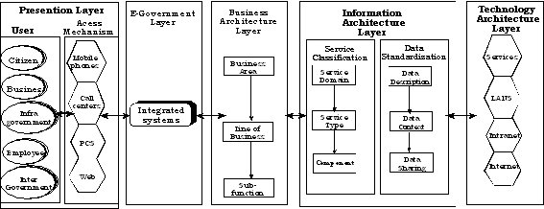

Slide 19
Presentation layer (user interface)
The presentation layer identifies and describes the system users, who require access to government information at different capacities, and the channels through which information can be accessed.
It is the visible part that citizens, business, and government employee interact with.
It includes citizens portals and web interface, Mobiles applications, Kiosks and other interfaces.

Slide 20
E-Government Layer
It focuses on actual delivery of government services.
Aims to optimize the services for various stakeholders (citizens, business and other government entities)
This layer often involves a Service Delivery Gateway to provide a single point access.

Slide 21
Business Architecture layer
It describe the government functions and process
It focuses on streamlining existing processes, reducing manual touch points and promoting collaboration among departments.
It also involves business process re-engineering to make transaction more efficient and user friendly.

Slide 22
Information Architecture Layer
This layer deal with the structure, organization and management of information (data) assets.
It includes data models, databases, metadata, and components that govern how information is captured, stored, processed and accessed.
It emphasizes common, centralized database to eliminate redundancy and ensure consistency.
This layer can be divided into two: Service classification sub-layer and Data Standardization Sub-layer
Service classification sub-layer
The service classification sub-layer classifies service components according to how they support business and performance objectives
It serves to identify and classify horizontal and vertical service components supporting government and their IT investments and assets.
It is organized across horizontal service areas independent of the business functions, providing a leverage able foundation for reuse of applications, application capabilities and business services.

Slide 23
Data Standardization Sub-layer
The data standardization sub-layer is flexible and standard based to enable information sharing and reuse across the government via the standard description and discovery of common data and the promotion of uniform data management practices.
It provides a standard means by which data may be described, categorized and shared. These are reflected within each of the three standardized areas;
Data descriptions
  Data descriptions, provides a means to uniformly describe data, thereby supporting its discovery and sharing.
Data context
  Data facilitates discovery of data through an approach to the categorization of data according to taxonomies.
Data sharing;
  Data sharing, supports the access and exchange of data; where access consists of ad hoc requests (such as a query of data access asset) and exchange consists of fixed, recurring transactions between parties, enabled by capabilities provided by both the data context and data description standardization areas.
  It provides guidance for implementing repeatable processes to enable data sharing in accordance with government-wide agreements encompassing national, county as well as other public and private non-governmental institutions.
  The intent is to mature, advance and sustains their data agreements in and iterative manner.

Slide 24
Technology Architecture layer
The technology architecture layer categorizes the standards and technologies that support and enable the delivery of service components and capabilities.
It includes
  Connectivity – high speed internet networks, broadband connectivity, and mobile networks form the backbone.
  Hardware – datacenters, servers, computers, mobile devices at both government and user ends.
  Software
This layer often Increasingly utilized cloud computing for scalability, cost-effectiveness, and accessibility

Slide 25
Interoperability Framework
Interoperability Framework is Set of standards and guidelines which describe the way in which organizations have agreed, or should agree, to interact with each other.
First Definition
E Government Interoperability Framework (eGIF) is a set of guidelines and standards to be followed by public sector information systems and processes, in order to achieve technical, organizational and semantic interoperability during service provision.
Second Definition
An e-government Interoperability Framework (IF) is a document or group of documents that specify a set of common elements such as vocabularies, concepts, principles, policies, guidelines, recommendations, standards, and practices for agencies that wish to work together, towards the joint delivery of public services.

Slide 26
IFs are seen by governments as promising instruments to boost the interoperability of their services and systems. Henceforth, many countries have created and published their Ifs.
The e-GIF, launched in September 2000 in the United Kingdom by Minister Ian McCartney, is usually considered the first IF published. Since then, many other countries have published their national IFs, not only because they perceive them as an important instrument to foster and facilitate interoperability of public systems but also due to financial and political pressures set by prominent and powerful organizations and institutions such as the European Commission, United Nations, and the World Bank.
An IF is “a strategic document containing specifications and standards to be followed in order to ensure interoperability among public administrations and their beneficiaries (citizens, businesses, other public administrations)”.
It “specifies a set of common elements such as vocabulary, concepts, principles, policies, guidelines, recommendations, standards, specifications and practices”, which provide guidance to practitioners about what to consider and do in order to enable seamless interaction within their public administration as well as with other public authorities.

Slide 27
The common elements set in an IF may cover multiple issues at a technical, semantic, organizational, or even at a legal or political level.
IFs are seen as promising instruments to boost interoperability. Many practitioners and academics consider that the creation and publication of a national IF and its adoption by the multiple public agencies may, gradually, generate the appearing of a favorable environment to naturally achieve interoperability.
The existence of IFs may thus ending up contributing to the improvement of the quality of services provided to citizens, to the reduction of agencies’ operating costs, to the improvement of the coordination of government agency programs, and to the increase of transparency and accountability of government.

Slide 28
Interoperability Framework for E-Governance
IFEG in Indian context would encompass agreed approach to be adopted by the public agencies that wish to work together towards the joint delivery of public services using ICT, to achieve above mentioned goals, namely exchange of data, meaning of exchanged data and agreed process.
An IFEG involves a common structure which comprises a set of standards and guidelines; the structure can be used by the public agencies to specify the preferred way that all stake-holders interact with each other to share the information.
It is synonymous to speaking a common language.

Slide 29
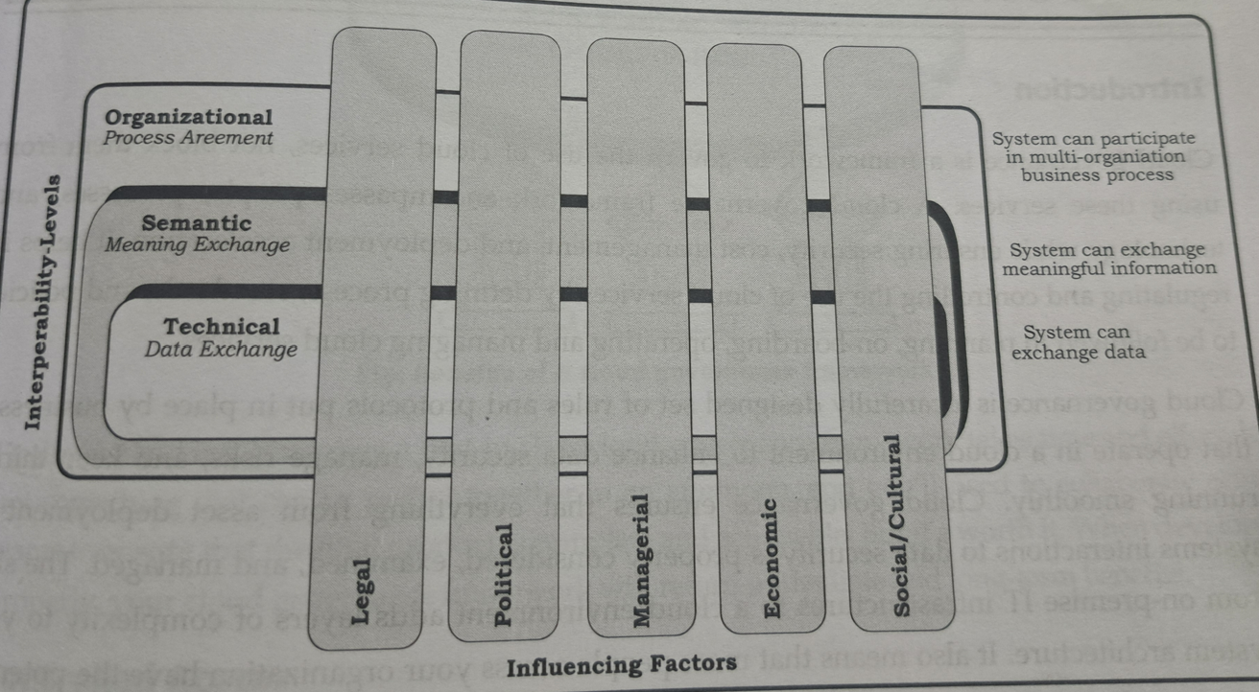
Levels of Interoperability
The interoperability levels related to the sharing of information in IFEG are mainly classified into:

Slide 30
Organizational Interoperability is concerned with how different organizations collaborate to achieve their mutually agreed e-government goals. (like process-re-engineering including Government-Orders, Process Changes, Organizational Structures),
Semantic Interoperability (Enabling data to be interpreted & processed with the same meaning, etc.)
Technical Interoperability : it covers the applications and infrastructures linking systems and services. (like technical issues in interconnecting ICT systems and services, information storage and archival, protocols for information exchange and networking, security, etc.); in general, technical interoperability was considered for classifying the standards into various layers or domains (eg. Presentation domain, Network domain, Data Interchange domain, etc.) in earlier versions of IFEG/GIF documents from various countries.
Figure provides an overall view of the levels of the interoperability system. This helps to define the way in which applications and re-usable services will be developed and their interaction with other ICT systems.
As indicated in the Figure, Organizational Interoperability is supported by Semantic Interoperability, which in turn is supported by Technical Interoperability.
Hence Technical Interoperability forms the basis for the IFEG. Governance facilitates and enforces the implementation of IFEG.

Slide 31
The Multilateral mechanism for IFEG is influenced by the following key sub-areas:
Political: For strategy related issues. In Political context, support and commitment from authority, provisioning of policies / guidelines, strategies over different levels of interoperability are expected.
Legal: For issues like IPR / Copy Right, content regulation, privacy, freedom of information, electronic identities, etc; these are context-sensitive. Legal factors include legal-power assigned to system for data protection and privacy information of the citizen, governance issues related to information management, executive orders and laws related to e-Governance services, citizen services driven by administrative procedures, enforcement, etc.
Managerial: For issues like training, motivation, reorientation of concerned staff from public agencies.
Economic: For funding related issues.
Social/Cultural: For social/cultural characteristics of system stakeholders. Social / Cultural factors like differences in culture, working practices, issues of trust, timings, social exclusion issues have more influence. Cultural and linguistic diversity introduces additional administrative constraints like naming conventions, multiple local official languages, language dependent format, etc.

Slide 32
Cloud Governance
Cloud governance is a framework to govern the use of cloud services
Cloud governance refers to the set of policies, procedures, controls, and best practices implemented by organizations to ensure the effective and secure use of cloud computing services.
As businesses increasingly rely on cloud-based infrastructure, platforms, and applications to store, process, and manage data, cloud governance becomes essential for mitigating risks, optimizing costs, and ensuring compliance with regulatory requirements
Fig: Interoperability Model

Slide 33
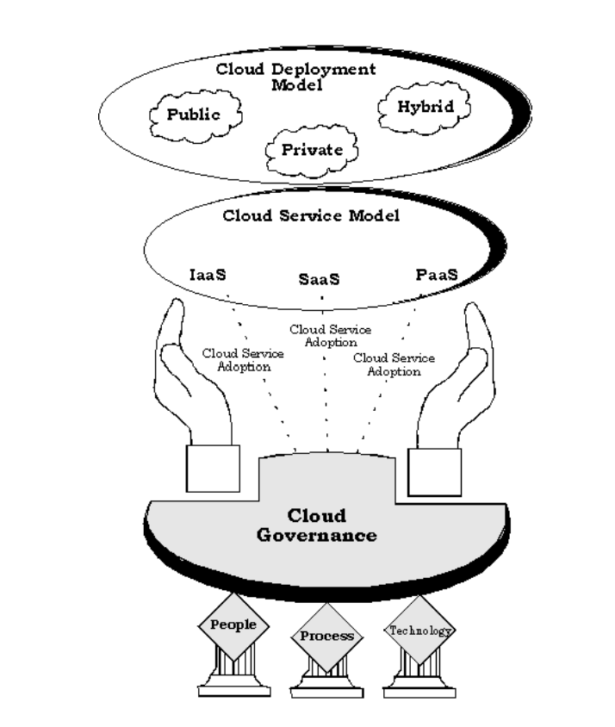
Cloud governance

Slide 34
Components of cloud governance
Cloud Strategy and Adoption: Developing a clear cloud strategy aligned with the organization's business objectives and IT goals. This involves evaluating the suitability of different cloud deployment models (public, private, hybrid) and service models (IaaS, PaaS, SaaS) based on factors such as scalability, flexibility, security, and cost-effectiveness.
Cloud Service Provider Selection: Establishing criteria for selecting cloud service providers based on factors such as reliability, performance, security capabilities, compliance certifications, data residency requirements, and contractual terms.
Data Governance: Implementing data governance practices to ensure the confidentiality, integrity, and availability of data stored and processed in the cloud. This includes defining data classification policies, access controls, encryption standards, and data retention policies.

Slide 35
Security and Compliance: Implementing security controls and compliance measures to protect cloud environments from cyber threats, data breaches, and regulatory violations.
Service Level Agreements (SLAs): Negotiating and managing SLAs with cloud service providers to ensure that agreed-upon service levels, performance metrics, uptime guarantees, and support commitments are met. SLAs should clearly define roles and responsibilities, escalation procedures, service credits, and remedies for service disruptions or failures.

Slide 36
Benefits
Controlled Access
  By designating who owns each area of asset and software management, your cloud governance plan will build necessary limits on who can access and impact your cloud ecosystem. As mentioned earlier, this is especially important considering how easy it is to implement new assets to the cloud. The last thing you want is rogue IT applications and initiatives tampering with your sensitive architecture. Controlling access to critical assets is vital and will enhance the reliability of your cloud processes.
Lowered Costs
  Cloud governance shifts workflows from manual to automated. Instead of relying on time-consuming manual processes (like crafting complicated spreadsheets to track various accounts and system activity), cloud governance programs allow you to build in guardrails that automate the management of everything from budgets to policies. These guardrails can also trigger automated responses to cloud activity, which reduces the manpower needed to enforce your cloud governance. And reduced manpower means reduced costs

Slide 37
Reduced Security Risks
  Once an organization has committed to moving their data to the cloud, it’s imperative that they develop the security measures to protect that data. While housing data on the cloud is certainly more convenient than hosting that data on-premise, it also brings increased risk for data breaches and unauthorized attempts to access data. Your cloud governance plan will help you identify vulnerabilities in your system, enact plans to mitigate risk, and establish metrics to gauge the impact of security measures.
Enhanced Compliance Readiness
  No matter your specific industry, it’s likely that you need to pass regular audits and compliance assessments. Whether you’re working with HIPAA, PCI, or SOC 2 requirements, your cloud governance program will streamline your compliance preparation and make it easier to demonstrate that compliance.
The benefits are two-fold. First, developing a cloud governance program with your particular compliance requirements in mind allows you to build compliance review and standards into your processes and architecture. Second, when it comes time to document your compliance, you’ll have a thorough archive of your system’s history, its current status, and your plans to enhance compliance.

Slide 38
Establishing cloud governance
Three phases in establishing cloud governance are
Plan | Build | Operate and manage
Define vision and scope Define service catalog Define government framework and tool Define KPIs to measure the effectiveness of the cloud governance | Define reference architecture Setup/configure tool Build governance organization Define standards, templates, polices and procedures | Monitors Measure KPI Optimize

Slide 39
Risk of Poor Cloud Governance
Cloud Security Risks
Cloud Proliferation and Sprawl
Cloud Integration (post proliferation)
Cloud Portability & Interoperability
Cloud Vendor Lock-In
Cloud Applications Governance – designing and migrating applications to appropriate Cloud pattern(s)
Lack of Incentives for Consumers to Onboard/Consume Cloud resources
Shadow IT and Hidden Clouds

Slide 40
E-readiness
"E-readiness" refers to the level of preparedness or readiness of individuals, organizations, communities, or even entire nations to effectively use information and communication technologies (ICTs) for various purposes, such as communication, education, business, and governance.
E-readiness (electronic readiness) is defined as a degree to which to a country or economy may be ready, willing or prepared to obtain benefits which arise from information and communication technologies. This measure is often used to gauge how ready a country is to participate in electronic activities such as e-governance.
E-readiness also defined as “The degree to which a community is prepared to participate in the Networked World, which is gauged by accessing a community’s relative advancement in the area that are most critical for ICT adoption and the most important of ICTs”
Is not simply a matter of the number of computer servers, websites and mobile phones in the country, but also things such as its citizen's ability to utilize technology skillfully, the transparency of its business and legal systems, and the extent to which governments encourage the use of digital technologies.

Slide 41
Requirements for E-readiness
Access to Infrastructure: This includes access to reliable and affordable internet connectivity, as well as access to devices such as computers, smartphones, and tablets. E-readiness depends on the availability of broadband internet infrastructure, mobile networks, and access points in both urban and rural areas.
Digital Literacy and Skills: E-readiness requires individuals to have the necessary digital literacy skills to navigate online platforms, use digital tools and applications, critically evaluate online information, and protect themselves from online threats such as cybercrime and misinformation. Digital literacy programs and educational initiatives play a crucial role in enhancing e-readiness at the individual level.
Government Policies and Regulations: E-readiness is influenced by government policies and regulations related to ICTs, including policies on internet access, digital rights, data privacy, cybersecurity, and e-commerce. Enabling policies that promote competition, innovation, investment in ICT infrastructure, and digital inclusion can enhance e-readiness at the national level.

Slide 42
Requirements for E-readiness…
Economic and Social Factors: Economic factors, such as income levels, affordability of ICT devices and services, and the availability of digital payment systems, can influence e-readiness by determining access to ICT resources. Social factors, such as cultural attitudes towards technology, social norms, and demographic characteristics, also play a role in shaping e-readiness levels within communities.
Collaboration and Partnerships: Collaboration among stakeholders, including governments, private sector organizations, civil society groups, and international organizations, is essential for improving e-readiness. Public-private partnerships, multi-stakeholder initiatives, and international cooperation can help address gaps in ICT infrastructure, digital skills, and policy frameworks.

Slide 43
E-Readiness: Infrastructural Prerequisites
E-readiness means infrastructural pre-requisites for taking up e-governance initiative.
The infrastructural prerequisite or preconditions may be identified as:
1. Data Systems Infrastructure
2. Legal Infrastructure
3. Human Infrastructure
4. Institutional Infrastructure
5. Technological Infrastructure
6. Leadership and Strategic Planning

Slide 44
Data System Infrastructure
The core of e-governance is e-MIS, the Electronic Management Information System and holds the entire database of any organization .
The data that were managed manually or conventionally needs to be computerized or brought into electronic form which means that the prepare of computerized MIS and database or data warehouse is required in e-governance.
Data quality and data security are of prime concern i.e. extremely important here as most of the government environments in developing countries, infrastructural arrangements are not up to the mark.
The fundamental question that arises here is “ Are all the requisite management information systems, records, databases and work processes in proper place so as to provide the quantity and quality of data to support the move to e-governance?”
If not, these have to be built up with great effort and patience.
  This is the core computerization activity of any government process which may take several years to reach this stage.

Slide 45
Legal Infrastructural Preparedness
Legal Infrastructural preparedness refers to the readiness of legal systems, frameworks, and institutions to respond effectively to various challenges and situations, such as emergencies, crises, or changes in societal needs.
The manual processes and procedures in government are usually obsolete, inefficient, bureaucratic and red tape based.
Though they have transformed to computerization practices, they continue to have poor and inefficient performance and this is due to lack of administrative reforms and lack of business process reengineering.
It is also due to lack of requisite legislation and legal infrastructure to enable such reforms or reengineering of the existing business practices, rules and regulations within the government at various levels.
This problem seems to be accentuated in developing countries while developed countries have been significantly successful in administrative reforms and business reengineering.

Slide 46
Legal Infrastructural Preparedness…
he fundamental question that arises here is “ Are the laws and regulations required to permit and support the move towards e-governance initiatives in place? “
  E.g Digital Signature Act are not yet accepted in many countries which lack the appropriate law for this.
The Information technology Act (IT Act) essentially provides an appropriate legal infrastructure for the use of digital signature.
The public key infrastructure is being given the legal sanction and support before it can be implemented.
Apart from these statutory laws pertaining to IT, individual legal acts and legislation may be required for enabling smooth and successful implementation of specific e-governance(e.g. legal acceptance of a computer printed document)

Slide 47
E-Readiness: Institutional Infrastructural Preparedness
For any government to implement a successful e-governance project, the required institutional infrastructure must be in place which most of the government lack.
The government body has to establish a separate IT department which basically coordinates with facilitators for e-government projects within the nation.
The activities of such institutes are varied from hardware selection and procurement to networking or software development and implementation and also the training of staff at various levels of the government.
Many countries still lack the institutional infrastructure.

Slide 48
E-Readiness: Human Infrastructural Preparedness
Human resource development by training is an essential requirement which comes from well trained manpower both technical and non-technical.
The technical manpower resources are essential for all the phases of e-governance and related information system life cycle comprising systems analysis, system design, programming, implementation, operation and documentation.
Both private and government institutions should play a major role in this regard.
Apart from technical human infrastructure, for software development and implementation of e-government projects, there is a need for the crucial training and orientation of user personnel i.e. government staff in e-governance project.
The government employees and staff who are the stake-holders in all e-government projects as the end users are to be appropriately trained and oriented for change management from a manual government environment to e-governance environment.
Such training will make them competent and capable of handling e-governance projects at operational level.

Slide 49
E-Readiness: Technological Infrastructure Preparedness
Technology is fast changing in ICT domain and there is a rapid obsolescence of software as well as hardware and the maintenance and support they require results in great financial demands from time to time.
Government organizations encounter this situation especially as their procedures to procure hardware or software etc are very inefficient and slow.
The technological infrastructure in developing countries including computing and telecommunication is conspicuous by its absence.
As a result software and hardware may not be compatible.
The major reasons are
  cost of technology
  Adaptability
  Obsolescence
This is a serious limitation to e-governance implementation.
Innovative Solutions to solve the problem of funding are being explored by these countries.
The new technology domains as fibre optics enable low cost internet bandwidth.
Some countries are also making plans for broad band internet access.

Slide 50
Need of E-Readiness
E-readiness is defined as the aptitude of an economy to use information and communication technologies to migrate traditional businesses into the new economy. E-readiness reaches its optimal level when the economy is able to create new business opportunities that could not be done otherwise. The concept of e-readiness is important because its level can be a strong predictor of how well a country can perform in the new economy. An e-readiness assessment would provide policy makers with a detailed scorecard of their economy’s competitiveness relative to its international counterparts. Further, a breakdown of indicators allows policy analysts to pinpoint areas of strengths and weaknesses, thus providing a balanced perspective in guiding a country through the digital transformation.

